Slide 1
Heuristic classifier
November 2024
Andrea Corrado

Slide 2
Outline
Why building a heuristic classifier
Knowledge on roving signals: recap
Data preparation
Heuristic classifier: pseudo code
Performance
Conclusions
Appendices

Slide 3
Outline
Why building a heuristic classifier
Knowledge on roving signals: recap
Data preparation
Heuristic classifier: pseudo code
Performance
Conclusions
Appendices

Slide 4
Why building a heuristic classifier
So far:
A filtering pipeline has been proposed
Data have been aligned respect to a common point
Data have been cleaned from misleading signals
Now it’s possible to proceed with building a Heuristic Classifier.

Slide 5
Why building a heuristic classifier
Problem
Which model could act as baseline?
In literature there’s no evidence of AVNRT roving signals classification
Proposed solution
So, a first classifier, which could cover this role, could be a heuristic one based on prior information on these signals
Aim
Building a logical set of rules to classify roving signals exploiting the prior on them

Slide 6
Outline
Why building a heuristic classifier
Knowledge on roving signals: recap
Data preparation
Heuristic classifier: pseudo code
Performance
Conclusions
Appendices

Slide 7
Knowledge on roving signals: recap
Map A: indifferent
Atrial wave amplitude >0.5 mv
Simple and biphasic shape of atrial wave
No slow-path signal
Minor presence of the Ventricular component
Map B: effective
Complex atrial component within 0.1 and 0.3 mV
Higher ventricular component
Map C: dangerous
3 components: atrial activity, ventricular activity and His Bundle passage
Not fixed proportions between atrial and ventricular components
Clear and biphasic atrial component

Slide 8
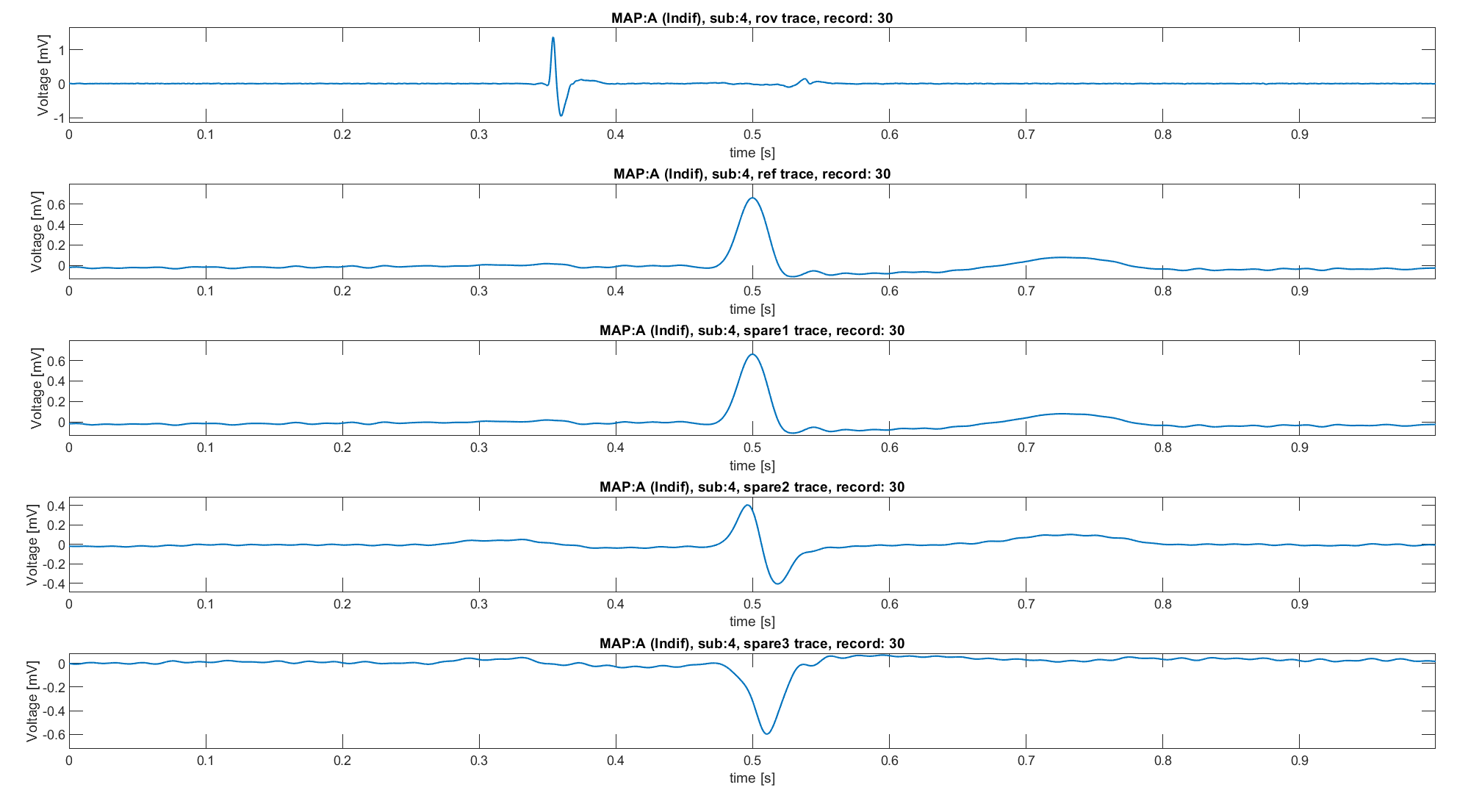
Knowledge on roving signals: recap
Map A
Atrial wave amplitude >0.5 mv
Simple and biphasic shape of atrial wave
No slow-path signal
Minor presence of the Ventricular component
ECG 1
ECG 1
Used for building the classifier
ECG 2
ECG 3

Slide 9
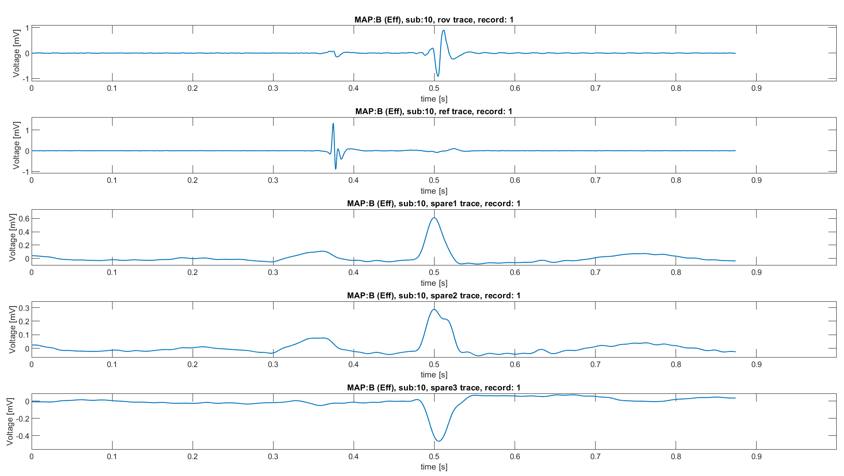
Knowledge on roving signals: recap
Map B
Complex atrial component within 0.1 and 0.3 mV
Higher ventricular component
CS 3-4
Used for building the classifier
ECG 2
ECG aVF
ECG V1

Slide 10
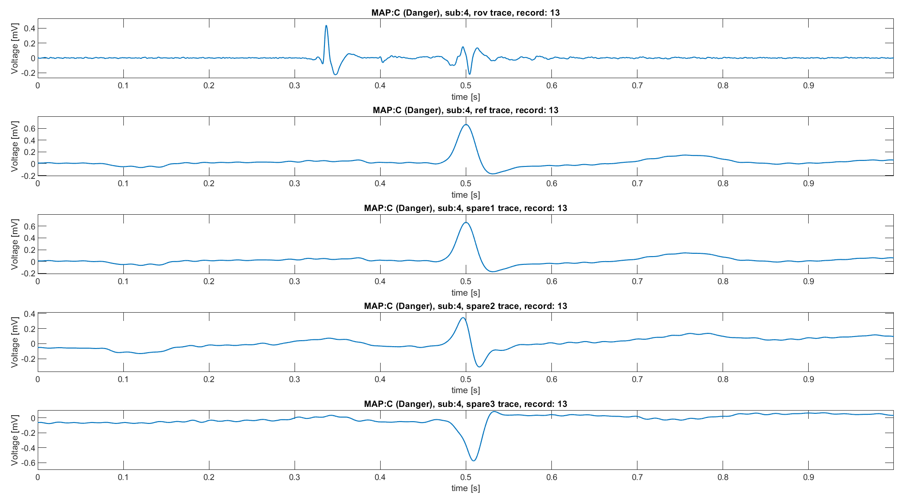
Knowledge on roving signals: recap
Map C
Clear and biphasic atrial component
3 components: atrial activity, ventricular activity and His Bundle passage
Not fixed proportions between atrial and ventricular components
ECG 1
ECG 1
Used for building the classifier
ECG 2
ECG 3

Slide 11
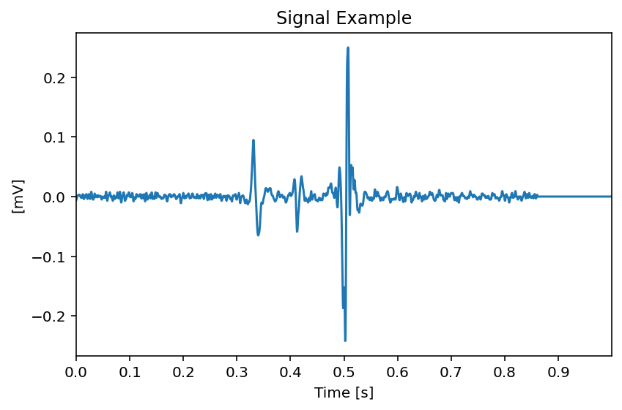
Time thresholds
For the moment, time thresholds have been introduced to distinguish between signals segments:
Atrial segment t<0.38
Ventricular segment 0.42<t<0.6
His segment 0.38<t<0.42

Slide 12
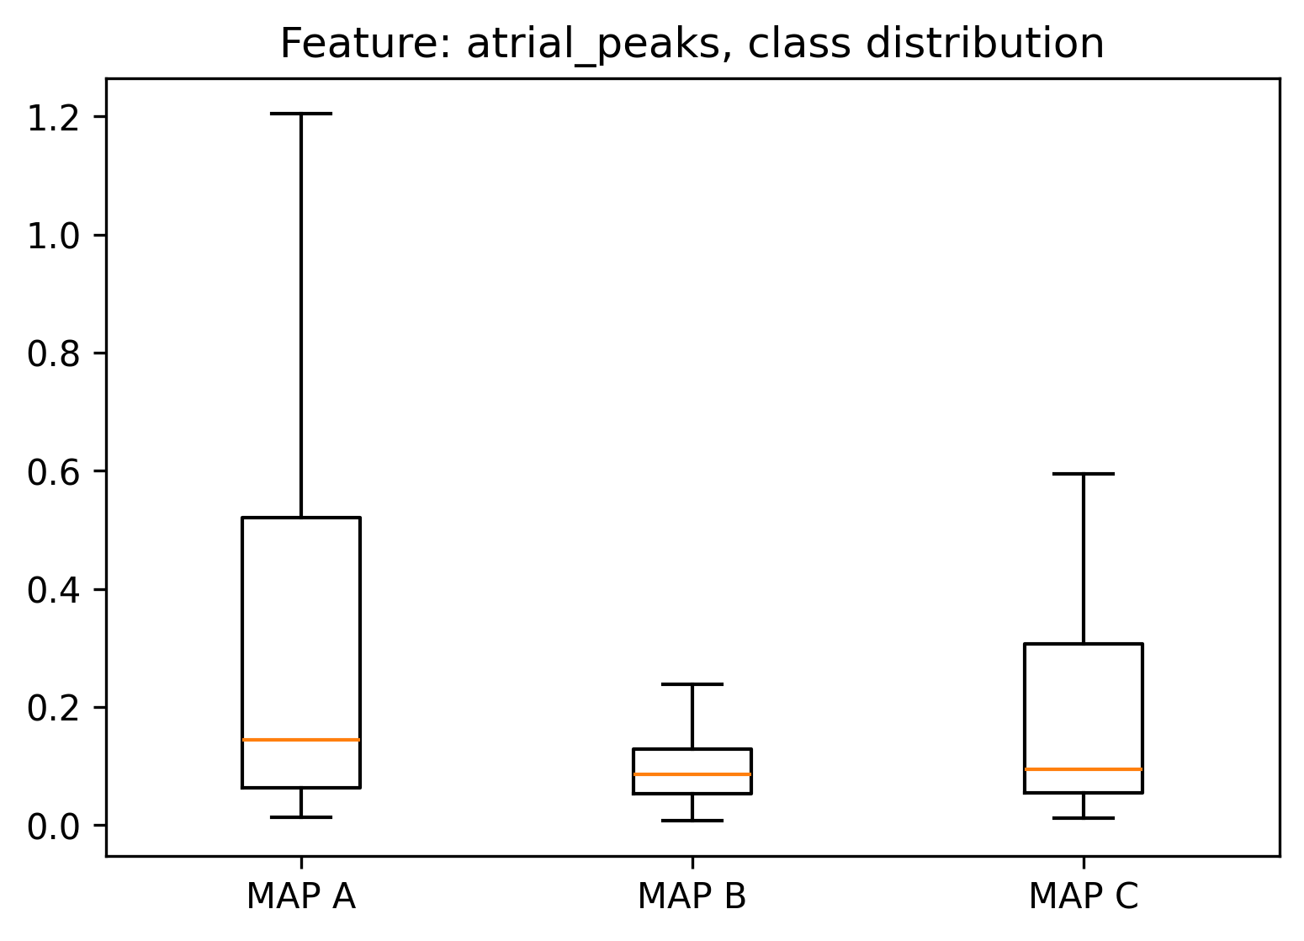
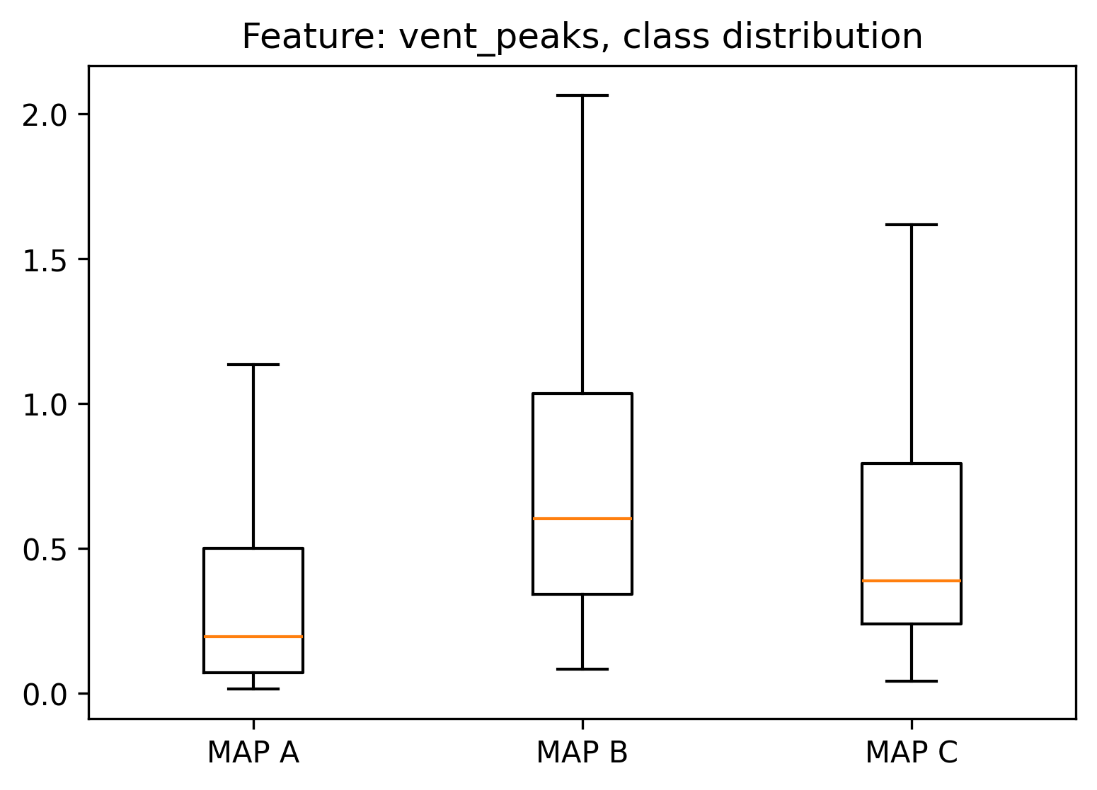
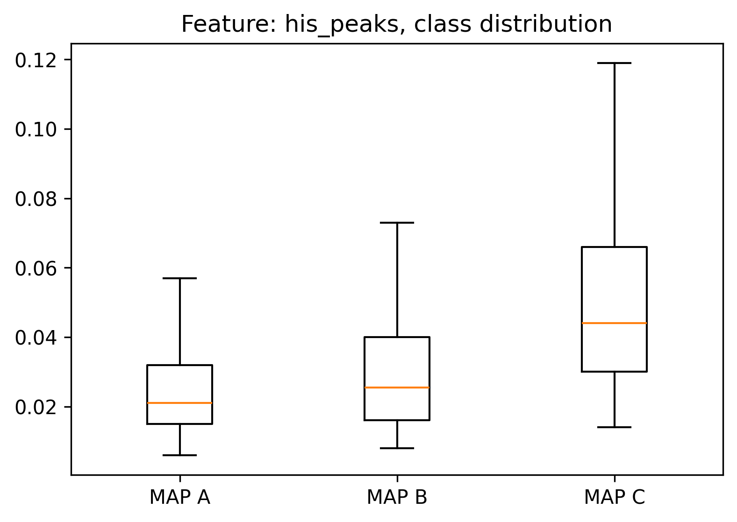
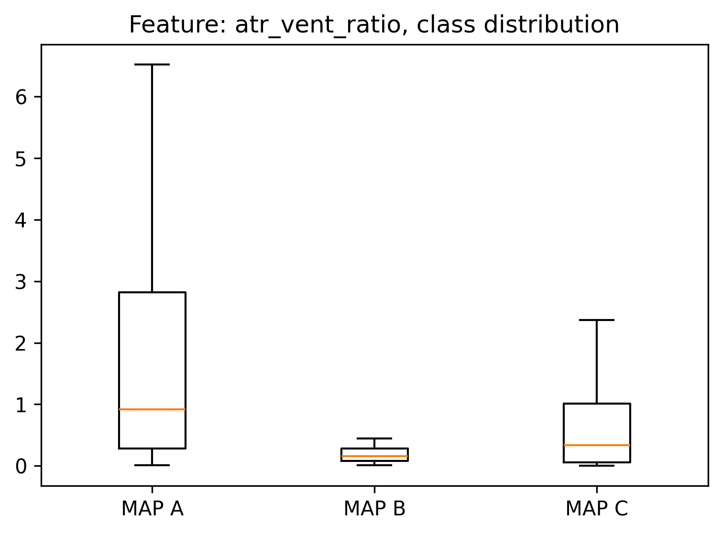
Are peaks discriminative?
To answer, atrial, ventricular and His peaks (maximum values into segments in modulus) have been valuated for each MAP:
Atrial or ventricular peak dominance can be summarized using atrial/ventricular peak ratio
Atrial peak does not seem to be discriminative of MAP A from MAP B, in contrast with literature. On the other hand, atrial/ventricular peak ratio opens to a possibility
His peaks seem to be discriminative respect to MAP A, but there’s a certain intersection with MAP B
All these observations depend on the time threshold introduced.

Slide 13
Outline
Why building a heuristic classifier
Knowledge on roving signals: recap
Data preparation
Heuristic classifier: pseudo code
Performance
Conclusions
Appendices

Slide 14
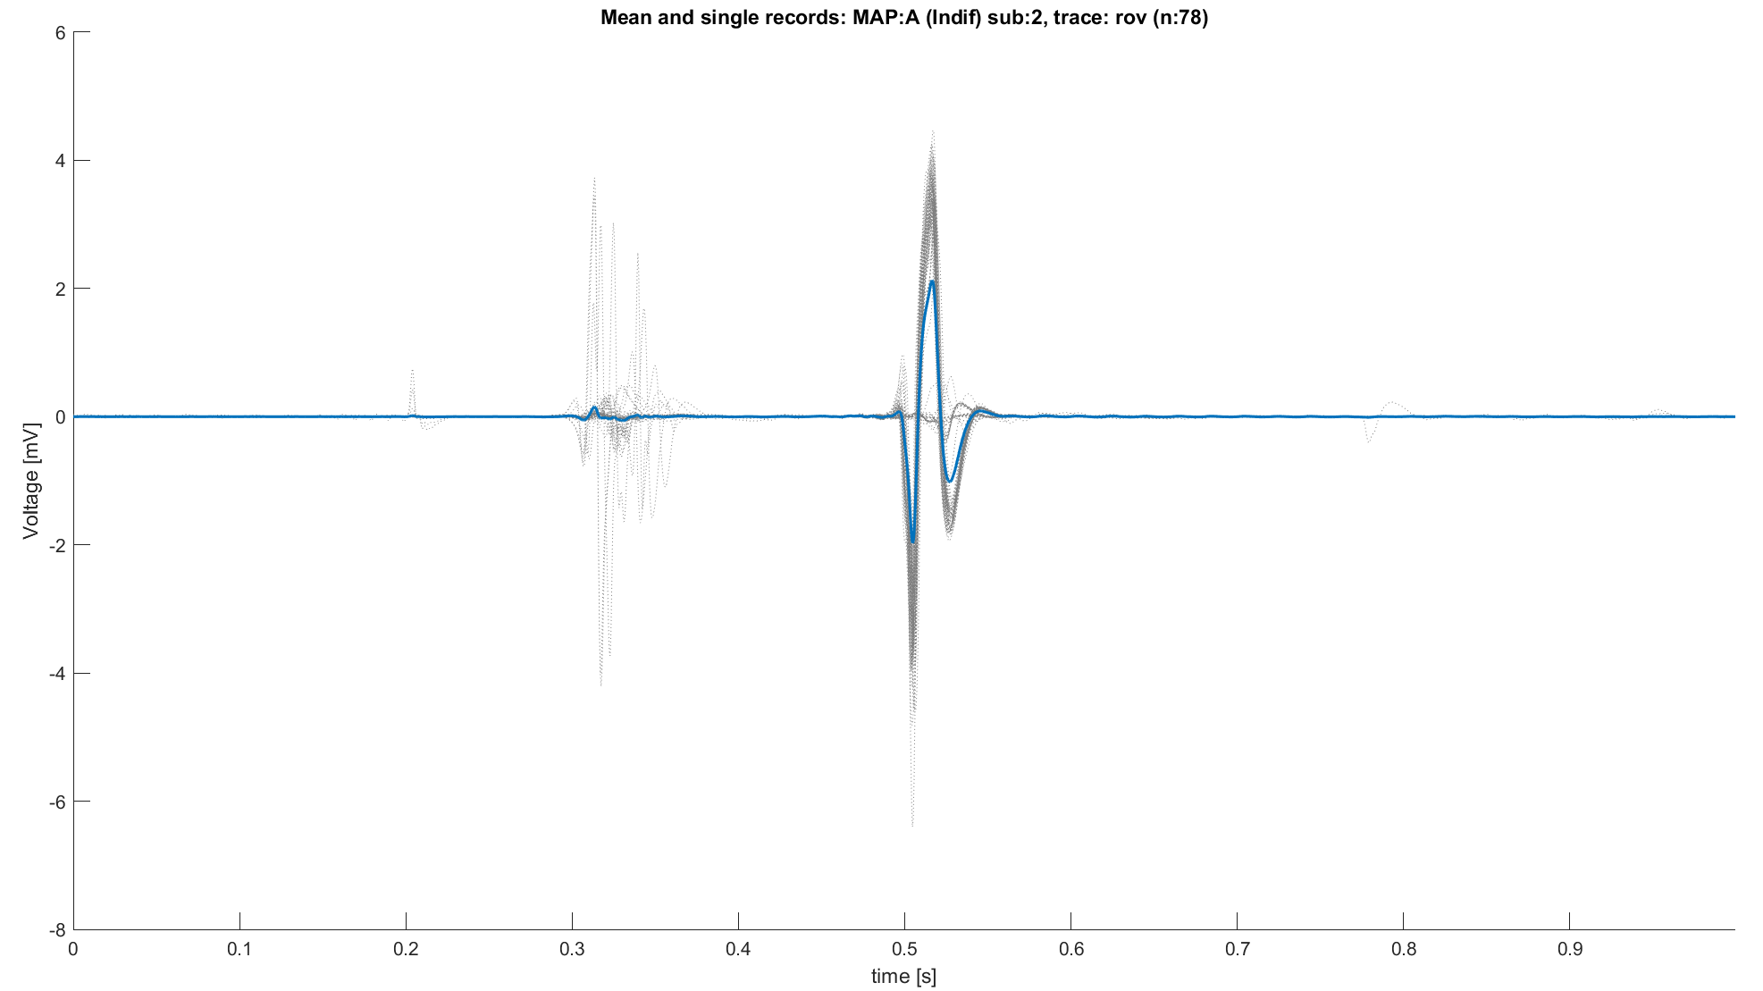
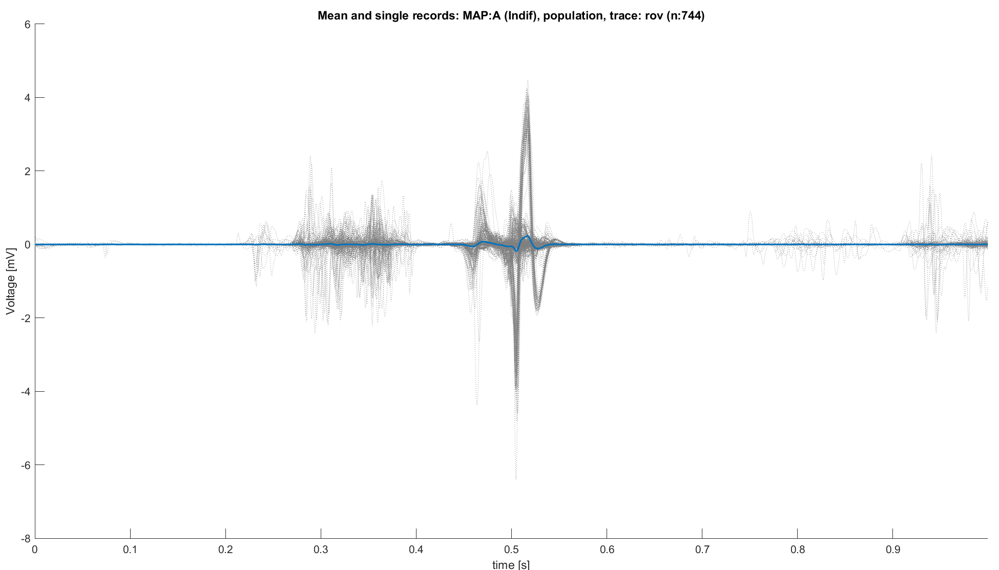
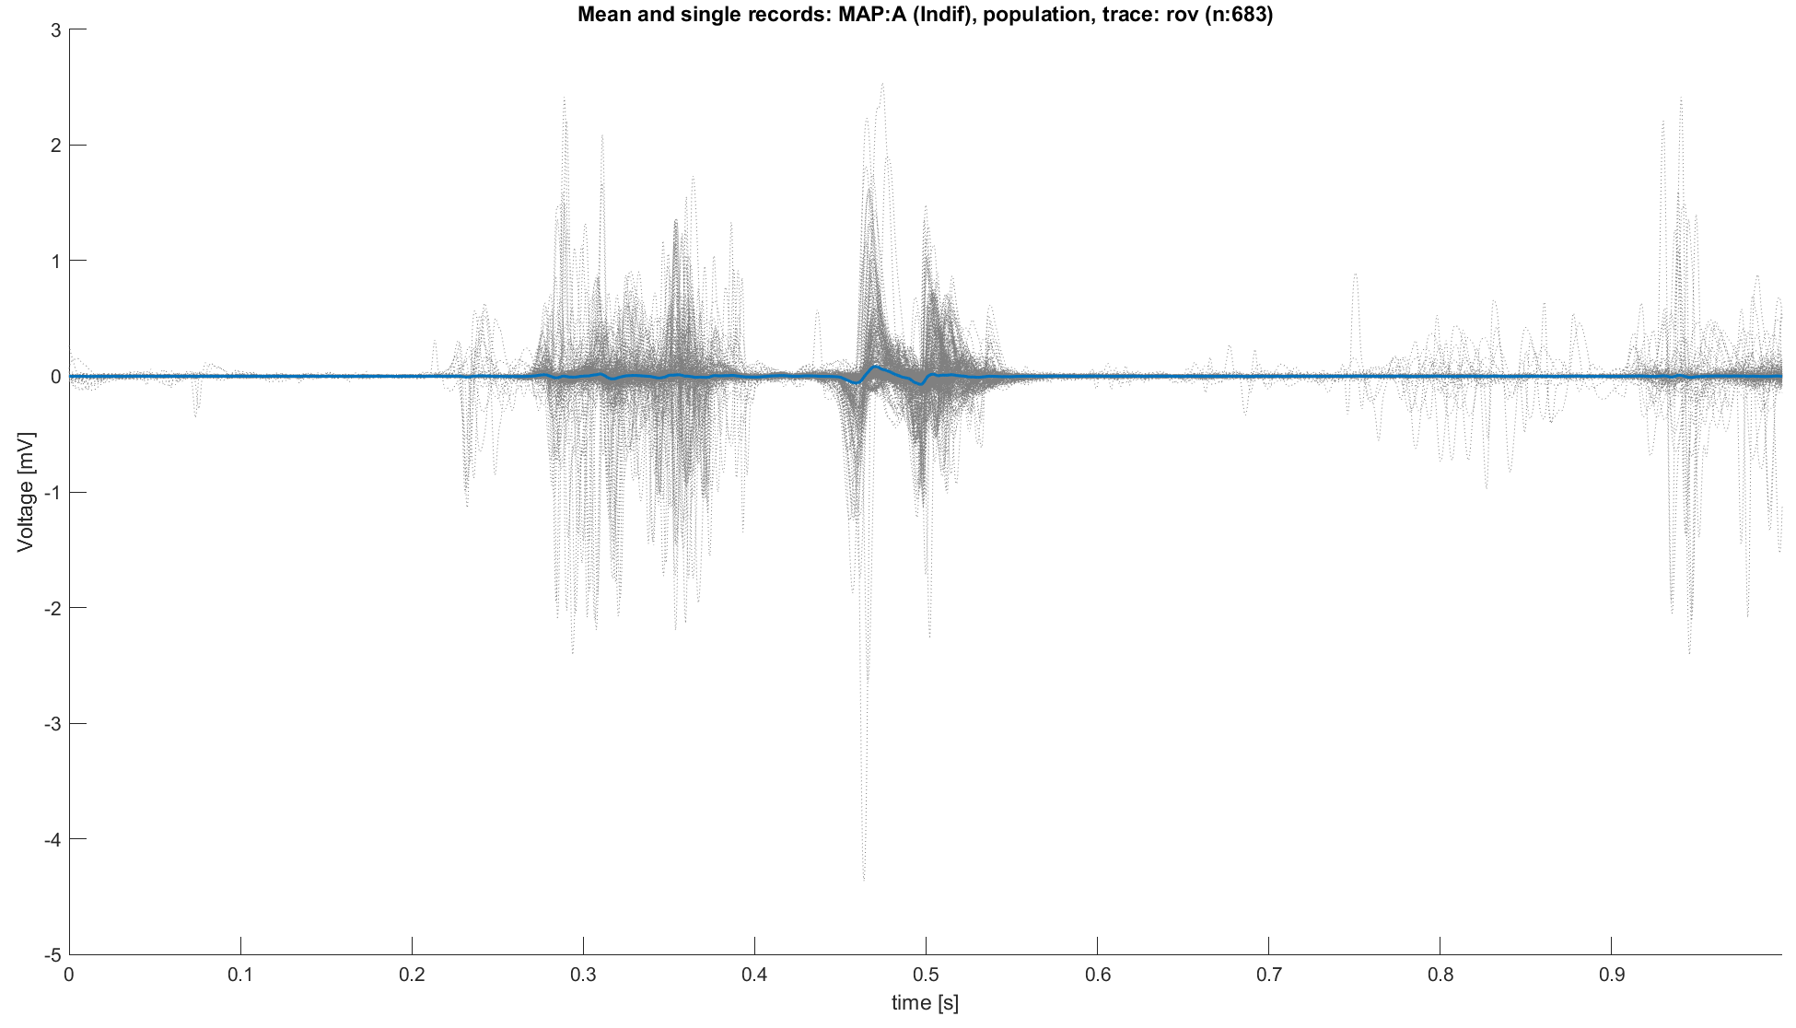
Data preparation: sub 2 exclusion
Before proceeding, a first observation should focus on the consistency of the signals with the expected behavior defined by the classification map
Subject 2 has almost the totality of MAP A signals with clearly MAP B characteristics.
So, while awaiting further understanding of how to interpret these signals, subject 2 has been excluded from the analysis.
MAP A signals with sub 2
MAP A signals without sub 2
Ref trace: ECG L1 with R peak on 0.5s

Slide 15
Outline
Why building a heuristic classifier
Knowledge on roving signals: recap
Data preparation
Heuristic classifier: pseudo code
Performance
Conclusions
Appendices

Slide 16
Heuristic classifier 1: atrial peak thresholding
For each roving trace (post-alignment):
Divide the trace in three segments:
Atrial: t<0.38s
Ventricular: after t>0.42
His bundle: 0.38<t<0.42
Compute the absolute value of the segment, then into each (modulus) segment find the maximum:
For atrial and ventricular phase take the maximum as it is
For His phase, consider the maximum and compare it with a threshold,
Then apply the following set of rules:
Is the His Peak above threshold?
No
Is the atrial peak > 0.3 mV?
No
NB: in this way MAP B, effective, is harder to be chosen, leading to a more “conservative” algorithm, as is should be the surgeon.
MAP A, indifferent, is chosen if atrial peak is higher than the threshold or if the higher than the ventricular one.
Finally, MAP C, dangerous, is chosen as first one if there’s an over-threshold peak into the His bundle.
MAP B
Yes
Yes
MAP C
MAP A

Slide 17
Heuristic classifier 1: atrial peak thresholding
For each roving trace (post-alignment):
Divide the trace in three segments:
Atrial: t<0.38s
Ventricular: after t>0.42
His bundle: 0.38<t<0.42
Compute the absolute value of the segment, then into each (modulus) segment find the maximum:
For atrial and ventricular phase take the maximum as it is
For His phase, consider the maximum and compare it with a threshold,
Then apply the following set of rules:
Is the His Peak above threshold?
No
Is the atrial/ventricular peak ratio >1?
No
MAP B
Yes
Yes
MAP C
MAP A

Slide 18
Outline
Why building a heuristic classifier
Knowledge on roving signals: recap
Data preparation
Heuristic classifier: pseudo code
Performance
Conclusions
Appendices

Slide 19
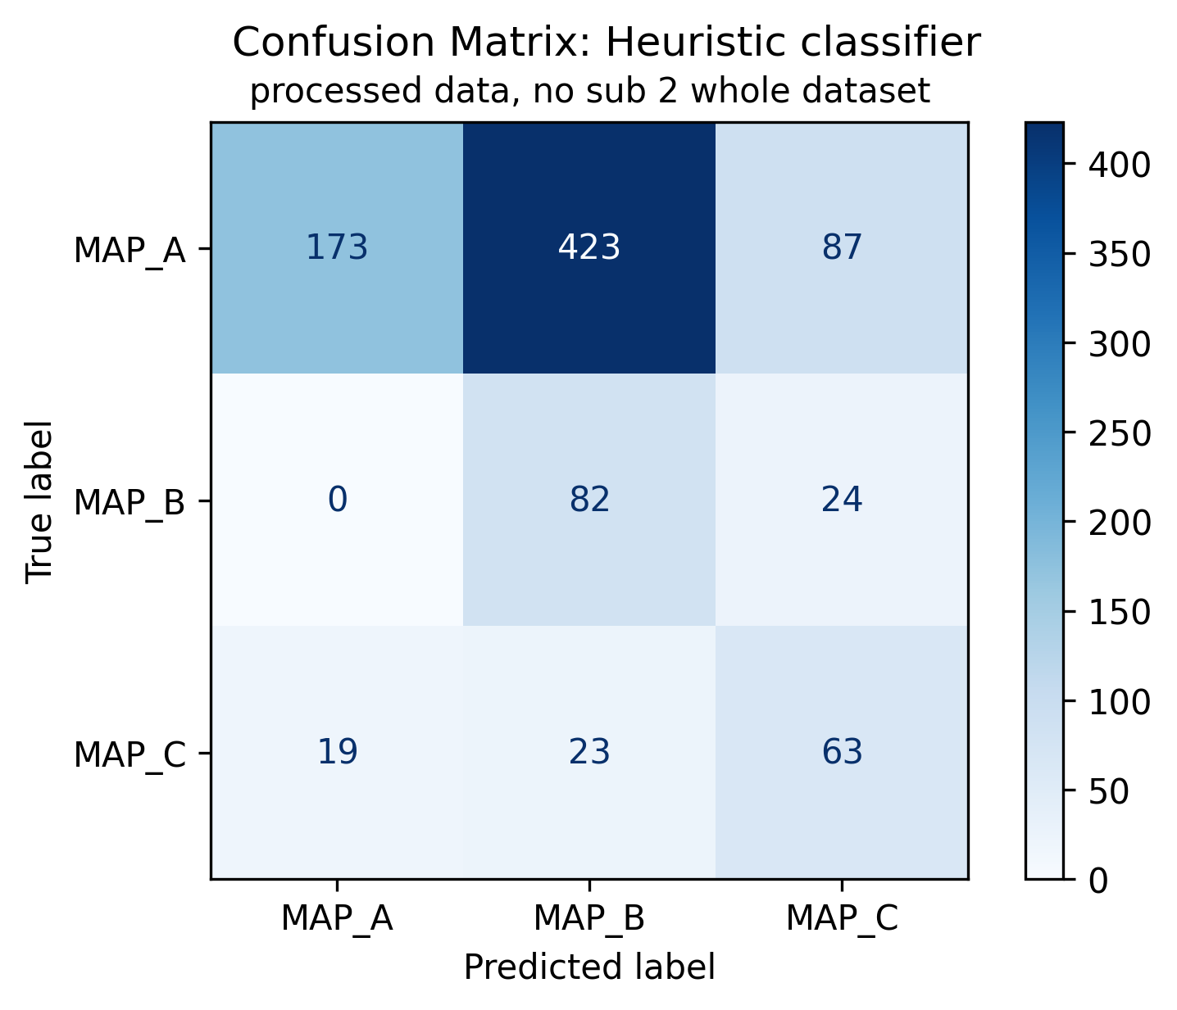
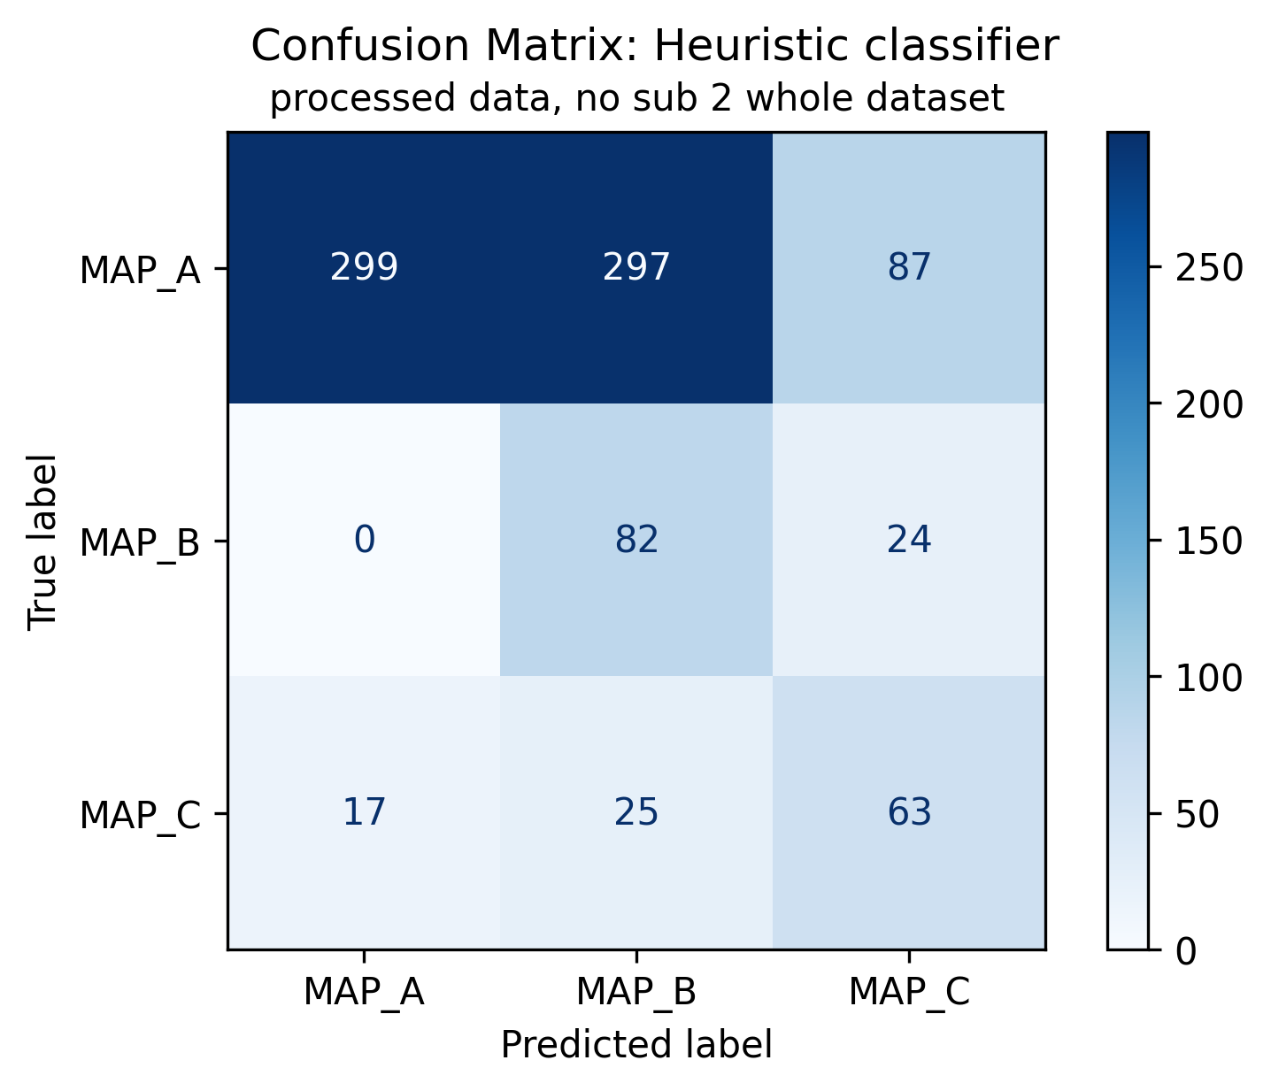
Heuristic classifier: results on original signals
Classifiers have been compared using confusion matrix
Atrial peak thresholding
Atrial/vent peak ratio

Slide 20
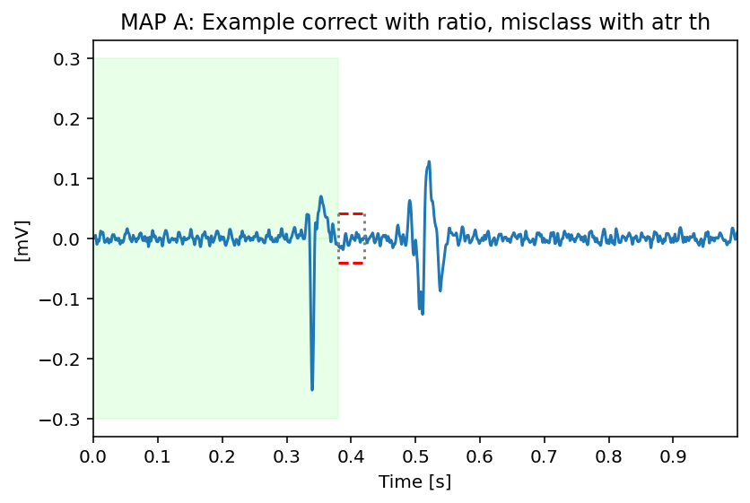
1 VS 1 classification result
This signal is an example of MAP A signal correctly classified using atrial/vent ratio but misclassified using atrial peak thresholding
Green boxes : MAP A atrial peak threshold, red dashed lines his peak thresholds

Slide 21
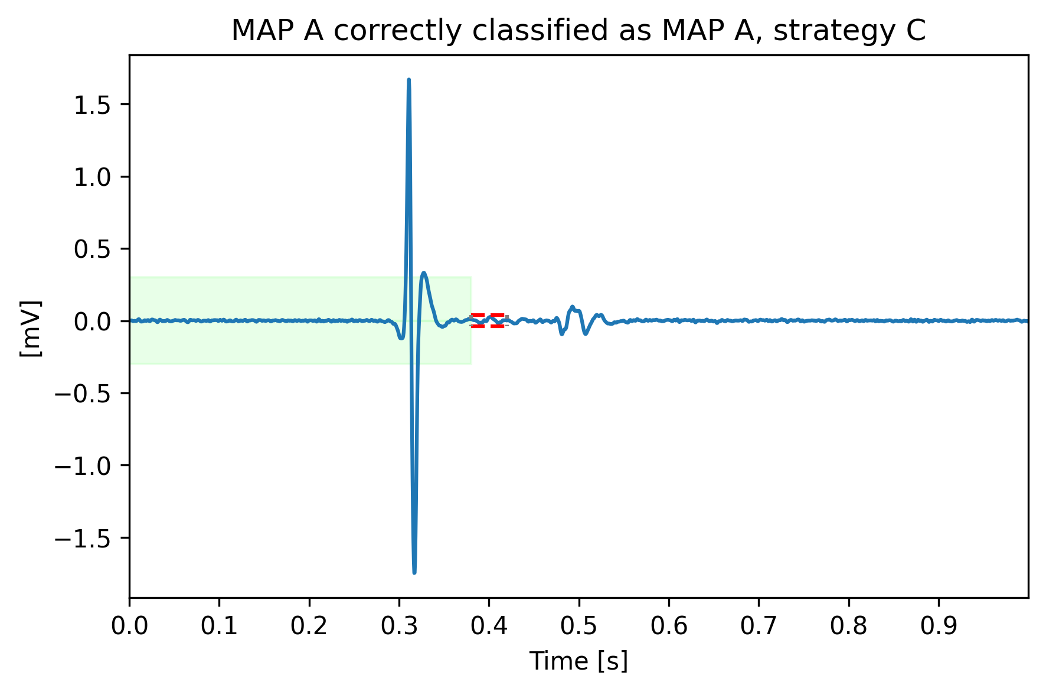
Correctly classified from both strategies: example 1
MAP A correctly classified
The algorithm recognize as majoritarian the atrial peak (in modulus)
Green boxes : MAP A atrial peak threshold, red dashed lines his peak thresholds

Slide 22
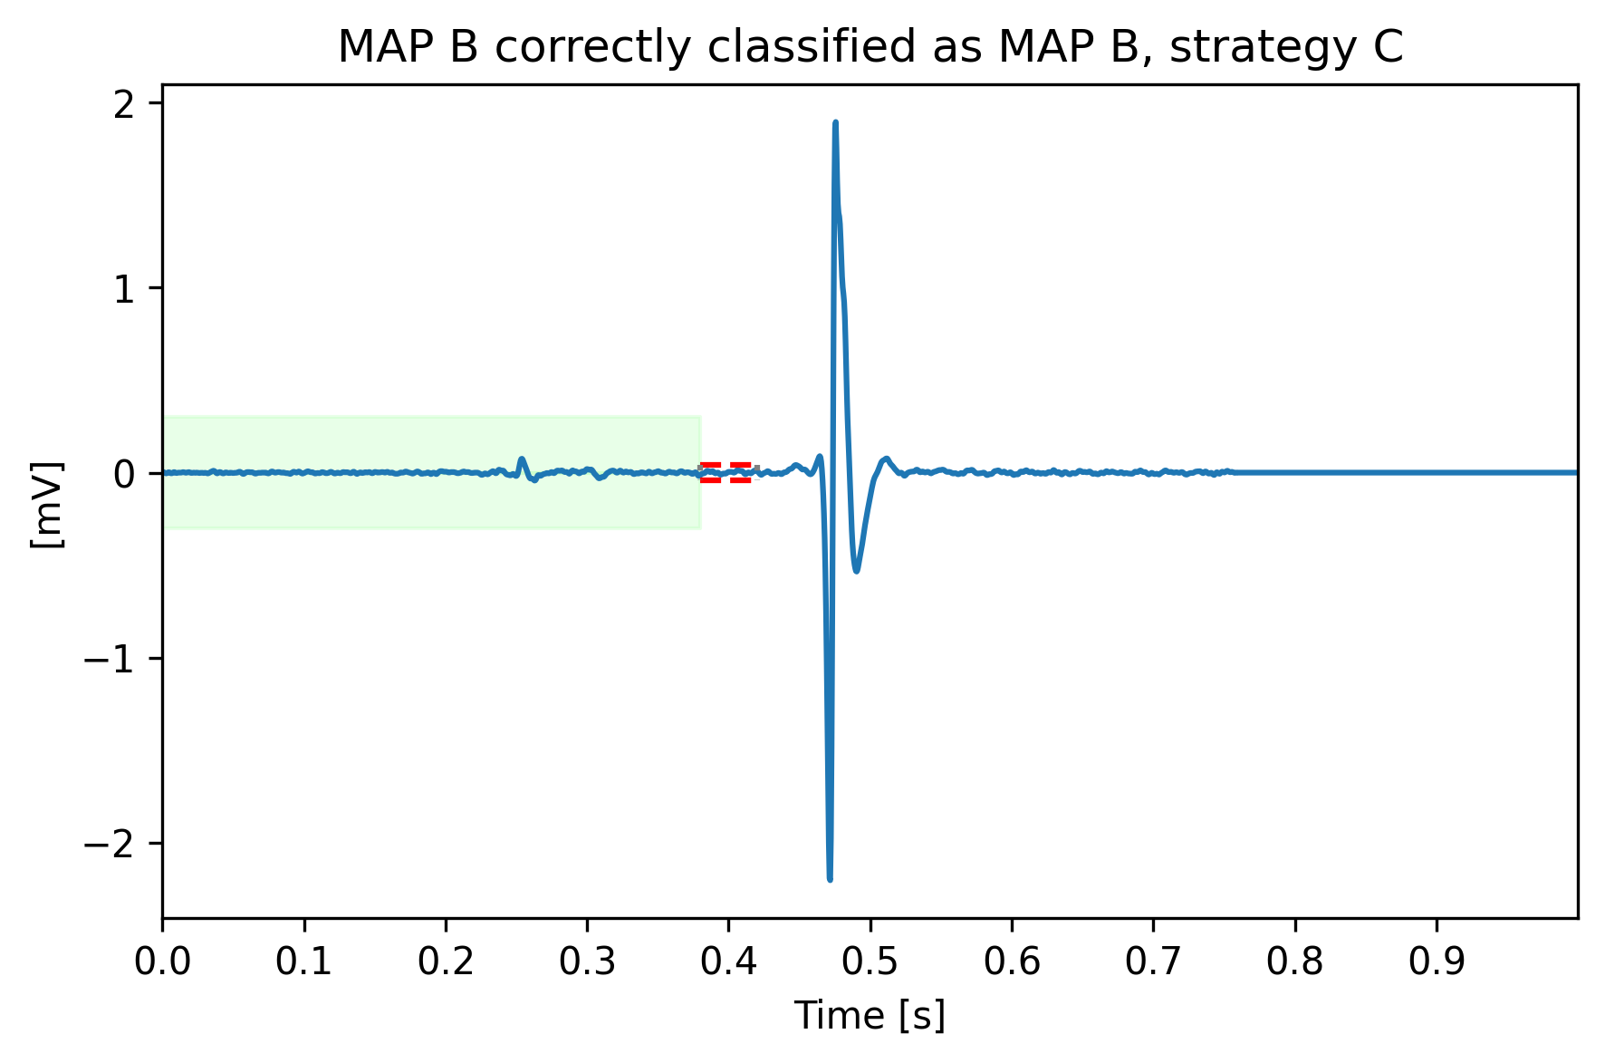
Correctly classified from both strategies: example 2
MAP B correctly classified
Higher ventricular peak is used to correctly assign this signal to map B.
Green boxes : MAP A atrial peak threshold, red dashed lines his peak thresholds

Slide 23
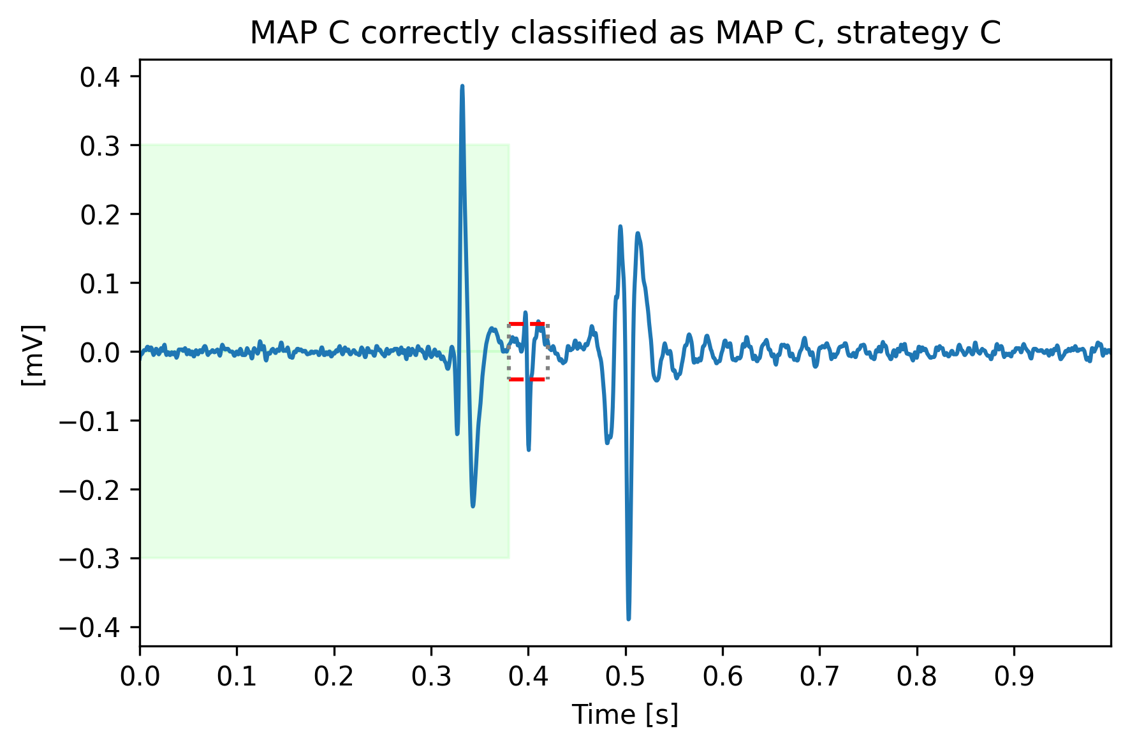
Correctly classified from both strategies: example 3
MAP C correctly classified
His bundle is correctly recognized and used to classify this signal into MAP C.
Green boxes : MAP A atrial peak threshold, red dashed lines his peak thresholds

Slide 24
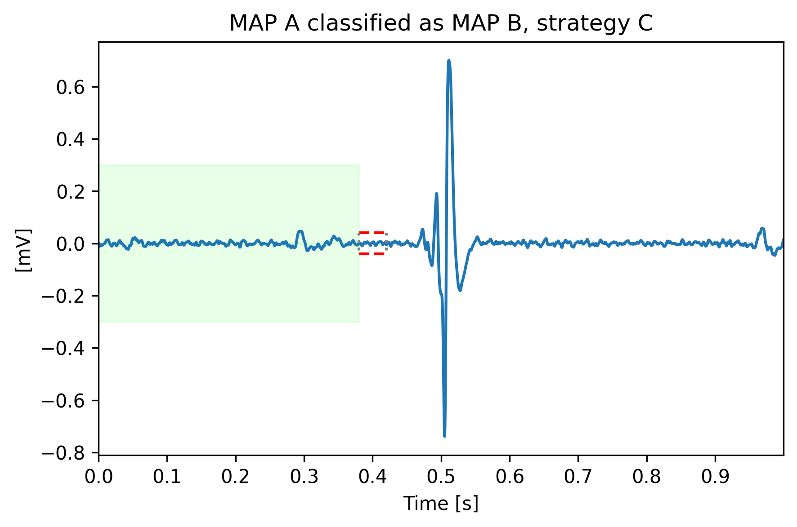
Misclassified from both strategies: example 1
MAP A classified as MAP B
The algorithm captures the uncertainty given by the clear Map B characteristics of the signal
Green boxes : MAP A atrial peak threshold, red dashed lines his peak thresholds

Slide 25
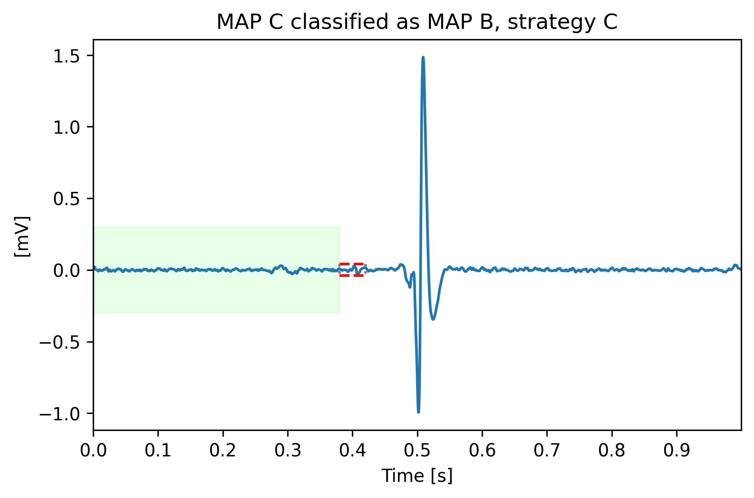
Misclassified from both strategies: example 2
MAP C classified as MAP B
Into this signal an His bundle oscillation is not clearly visible. Then, the signal is assigned to MAP B because of the higher ventricular peak
Green boxes : MAP A atrial peak threshold, red dashed lines his peak thresholds

Slide 26
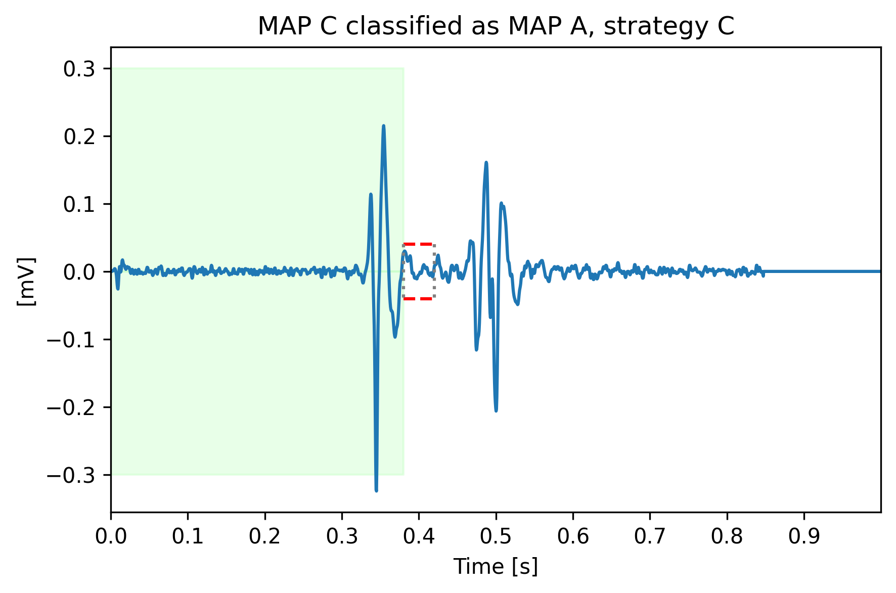
Misclassified from both strategies: example 3
MAP C classified as MAP A
His peak didn’t reach the threshold. Then, as it wasn’t considered significant, the signal is assigned to MAP A because of the higher atrial peak
Green boxes : MAP A atrial peak threshold, red dashed lines his peak thresholds

Slide 27
Outline
Why building a heuristic classifier
Knowledge on roving signals: recap
Data preparation
Heuristic classifier: pseudo code
Performance
Conclusions
Appendices

Slide 28
Conclusions
A heuristic classifier has been built with the purpose to act as baseline from which starting further evaluations.
In general, performance are not satisfying, as it could be imaged.
Looking at the confusion matrices and metrics, in both train and test sets:
MAP A has many misclassified into MAP B. Atrial/Ventricular peak ratio improves performances, while the threshold on atrial wave leads to misleading results.
MAP C has low precision and recall, leading to the conclusion that the threshold comparison result could be seen as a first hint to recognize these signals, but not sufficient.
An improvement can be considering a measure of noise of the signal and computing the His peak/noise ratio to assess if the peak is present.
The most important advantage of this algorithm is the full explainability of the decisional process.

Slide 29
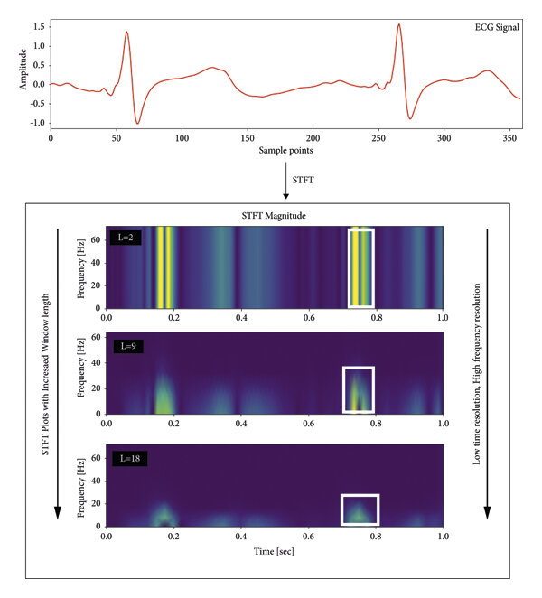
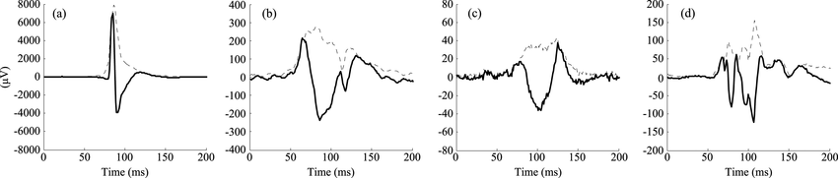
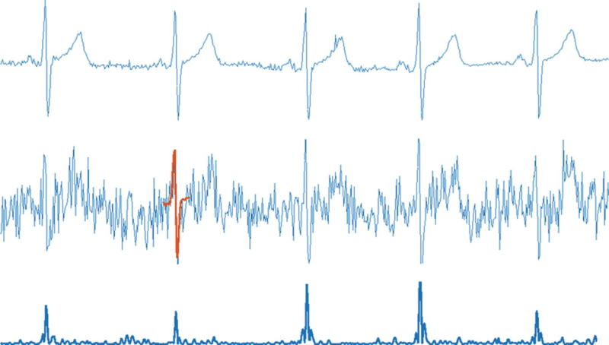
Conclusions
How could these results be improved?
Rectify the signal and compute its envelope to find the active portions
Using a template of a “biphasic wave” to compare with the signal and determine the portions of maximal similarity. A natural evolution of this technique is the Continuous Wavelet transform
Using time-frequency representations, like STFT or scalogram

Slide 30
Outline
Why building a heuristic classifier
Knowledge on roving signals: recap
Data preparation
Heuristic classifier: pseudo code
Performance
Conclusions
Appendices

Slide 31
Appendix 1: have been tried other strategies?
Strategy A
Prior: dominance between peaks
Peaks detection: find_peaks built-in function with prominence tuning applied on signal segments
First model used
Prominence not fully explainable
Strategy B
Prior: dominance between peaks
Peaks detection: max function and His threshold on His Segment
Best model in terms of performance
Full explainability
Prior not entirely used
Heuristic Classifier
Strategy B2
His threshold normalized respect to the signal amplitude
Strategy C
Prior: dominance between peaks and threshold on atrial phase
Peaks detection: max function and His threshold on His Segment
Almost all prior information are used
Respect to strategy B performance degradation is limited
Full explainability
Strategy C2
Usage of Atrial/Ventricular ratio as feature

Slide 32
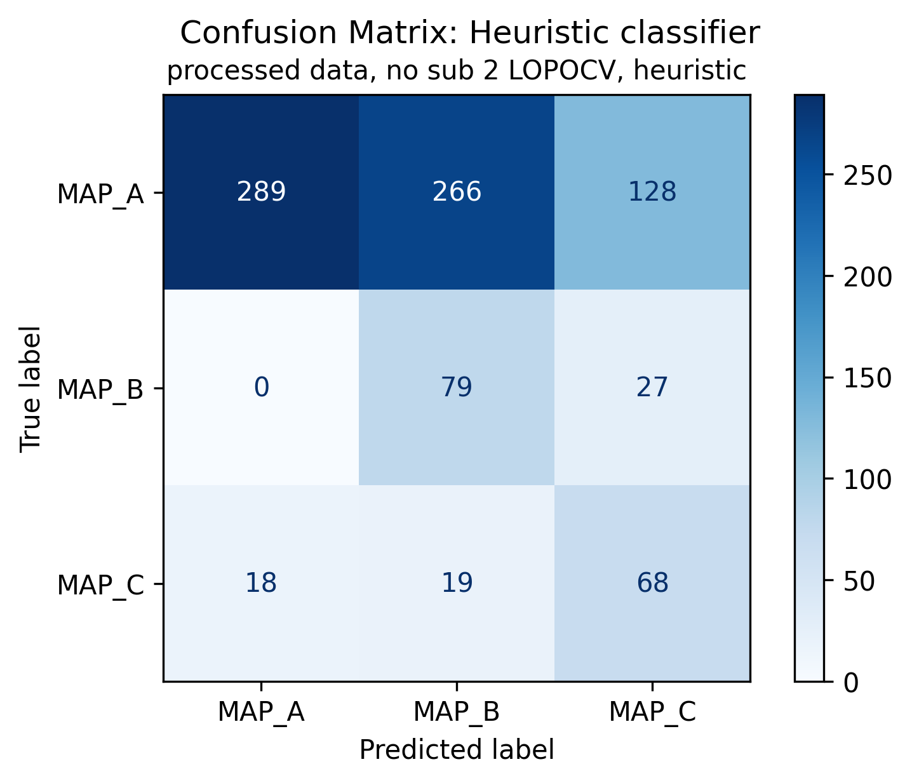
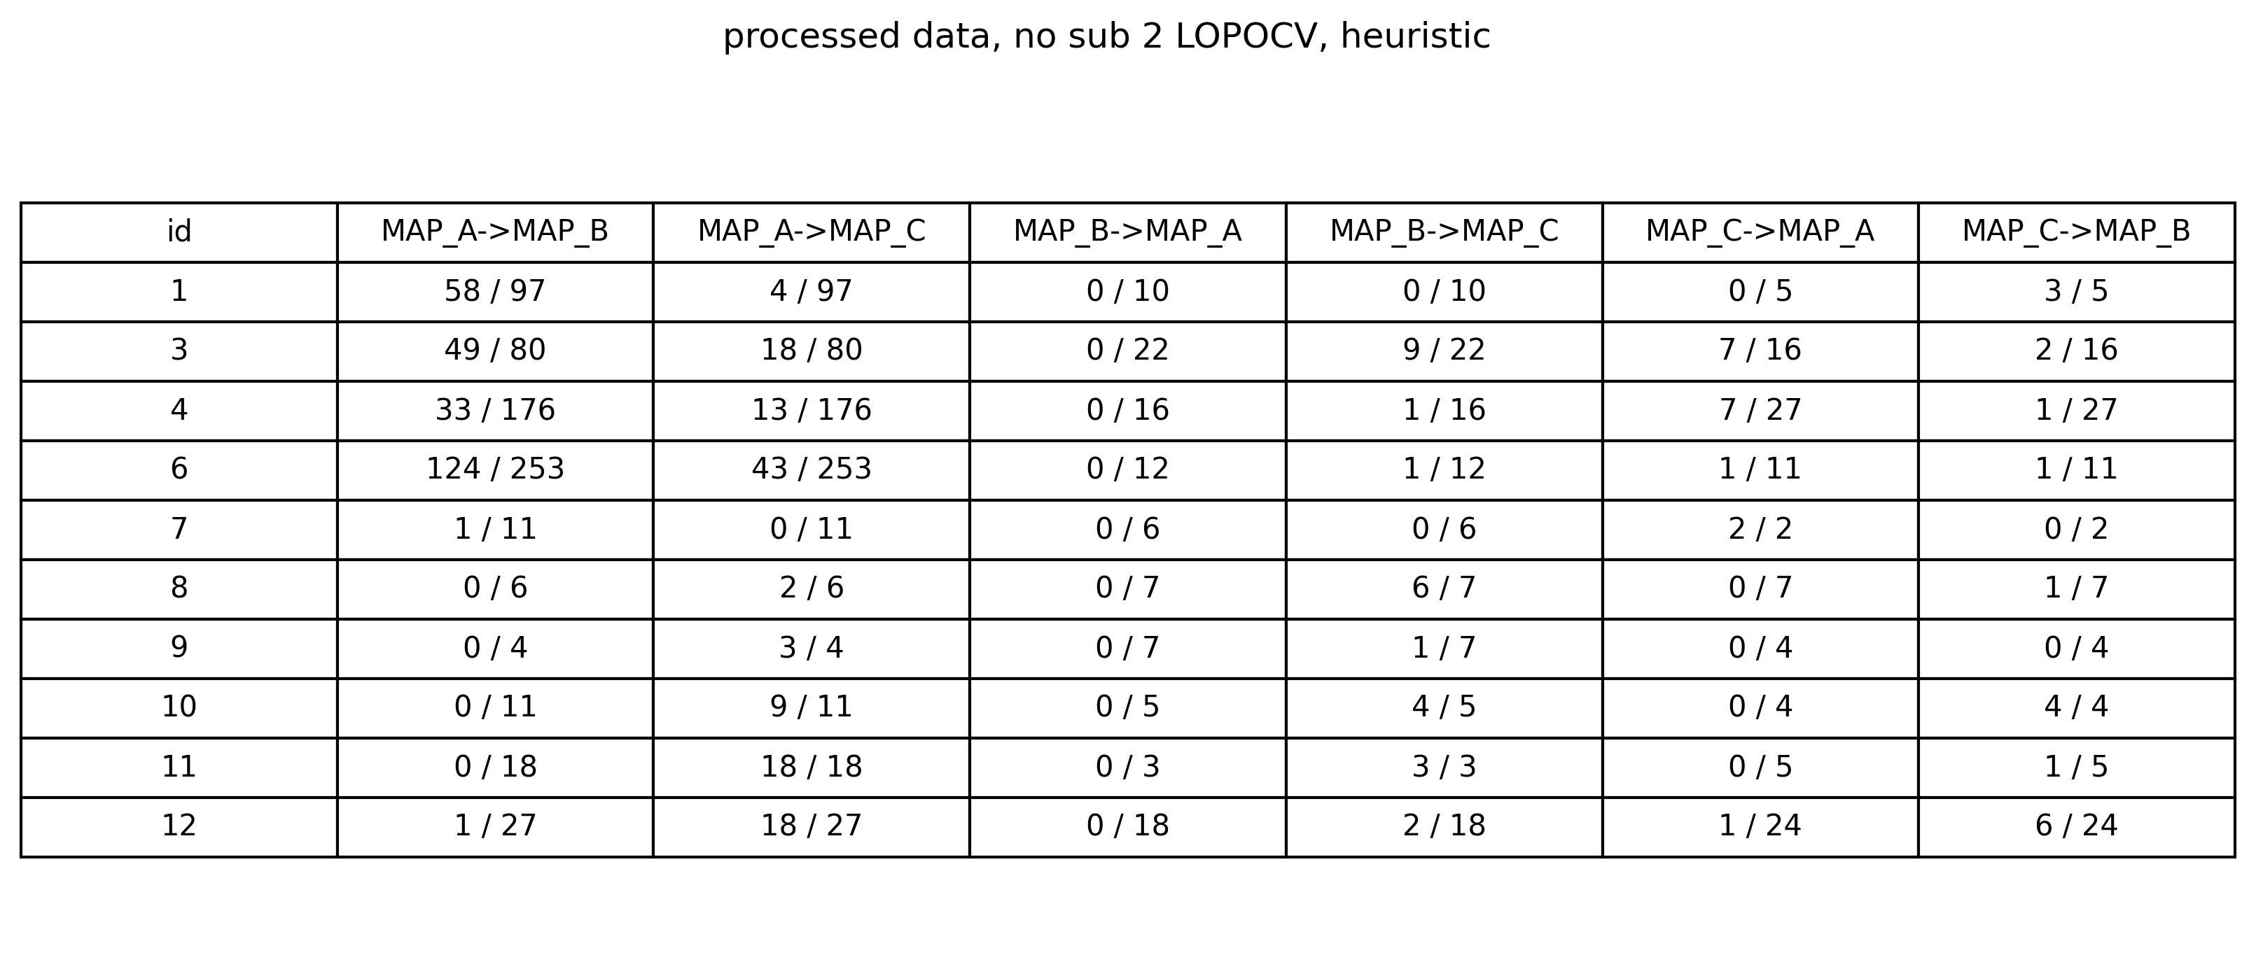
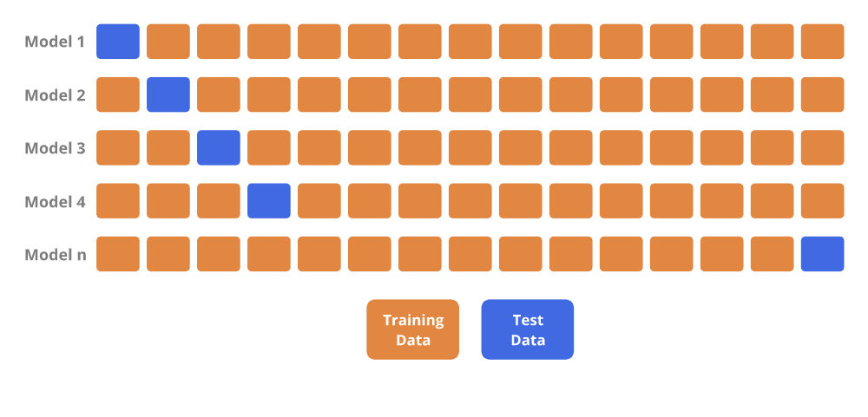
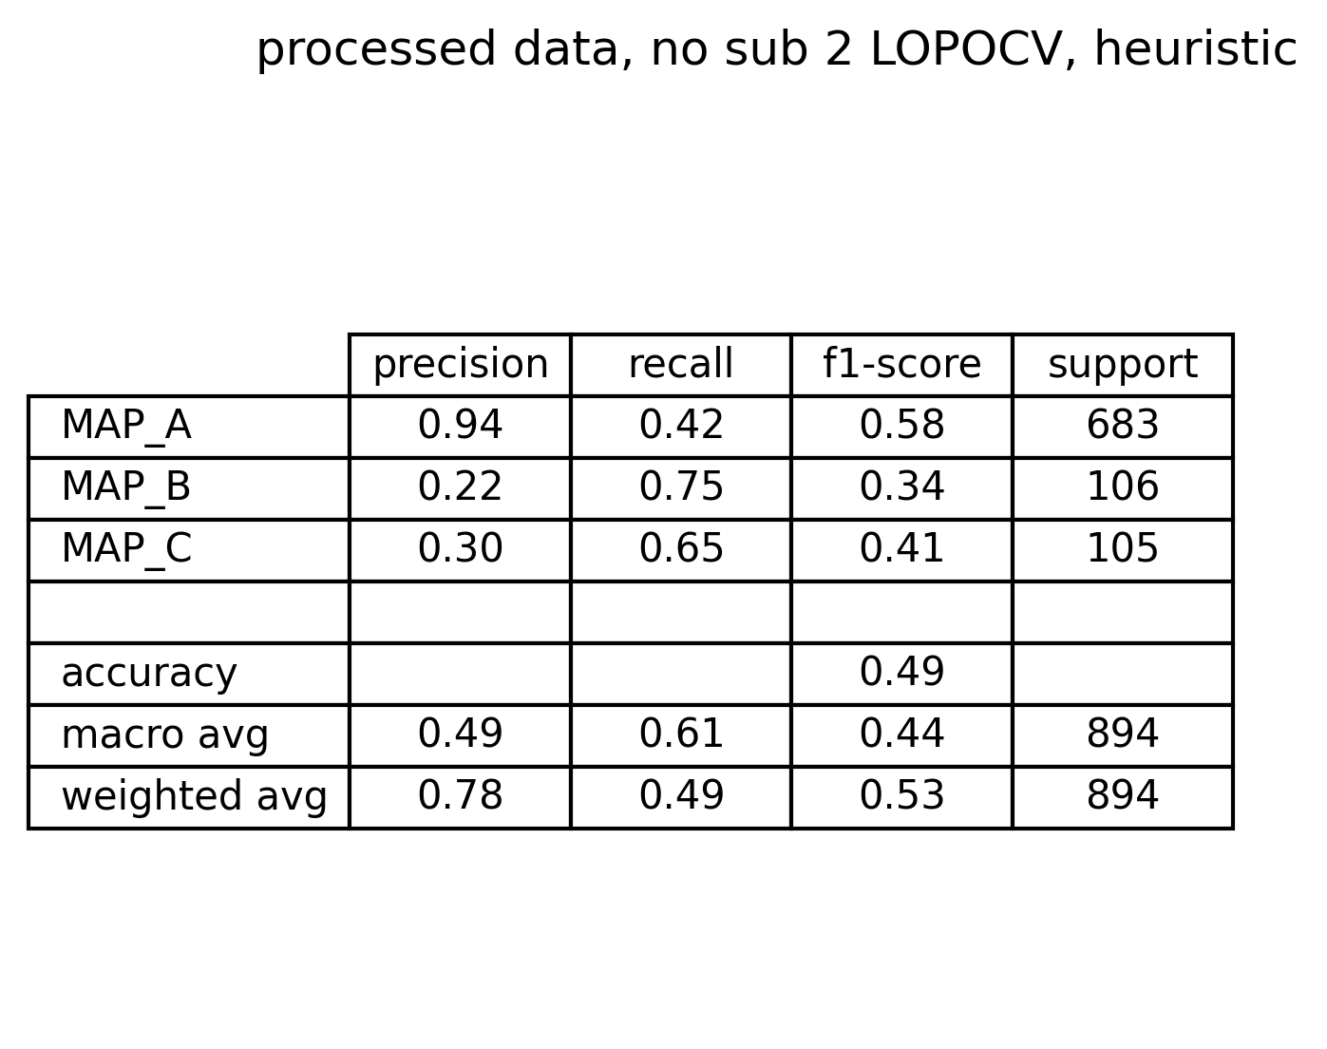
Appendix 2: what if LOPOCV is performed?
Instead of using a train/test split, one could try to match the inter-subject variability by using a Leave One Patient Out Cross Validation technique.
Iteratively, each patient is the test set while the others act as train set
The CM and the metrics summary are reported on the right (only for atrial/vent ratio strategy).
Metrics are comparable with the ones obtained with train/test split
In addition, respect to train/test split, this strategy allow to check the number of misclassified signals for each subject and for each class.
Seems that some subjects carry the greatest number of misclassifications (1,3,4,6) from MAP A to MAP B
Moreover, same subjects have the highest rate of misclassification from MAP A to MAP C

Slide 33
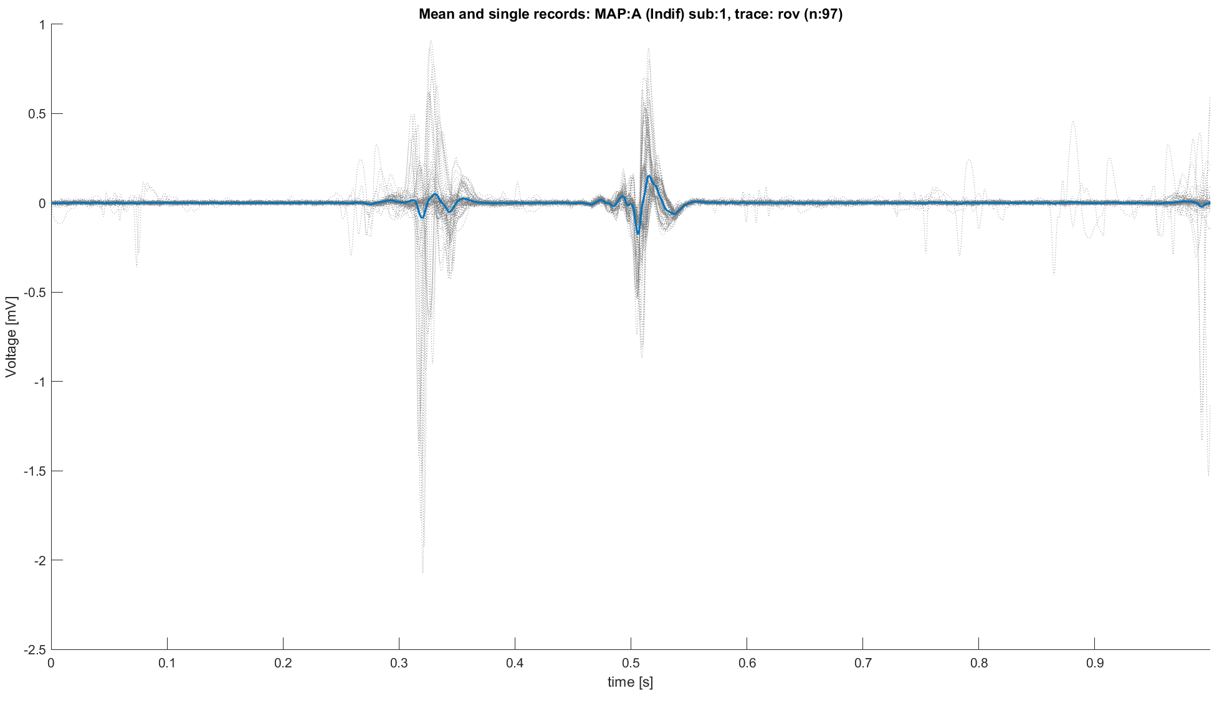
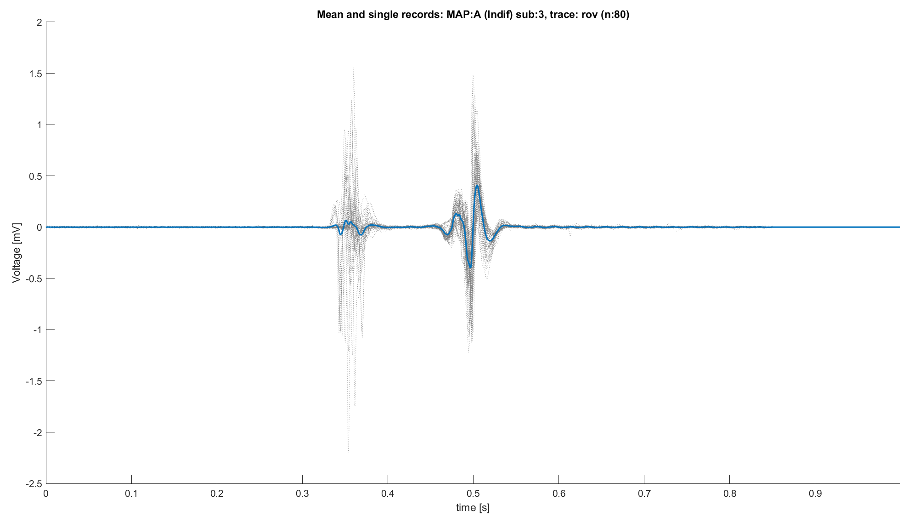
Appendix 3A: spaghetti plot of sub 1,3 MAP A
After Alignment sub 1
After Alignment sub 3
Misclassification due to presence of peaks into the ventricular part of the signal

Slide 34
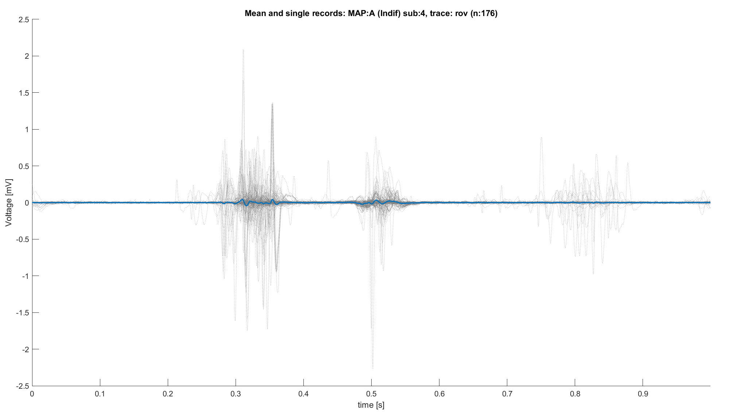
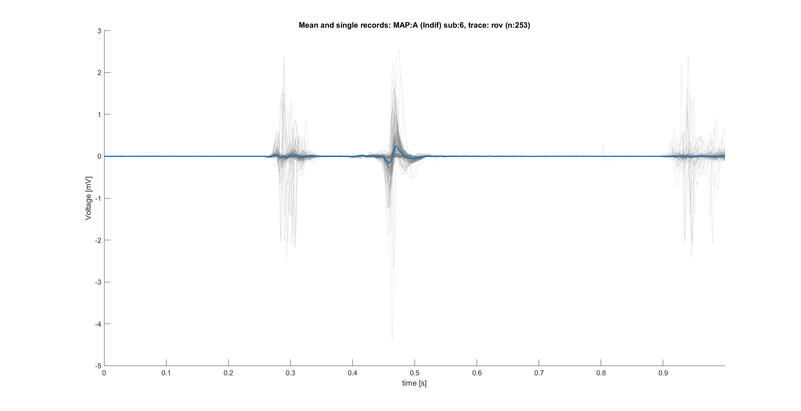
Appendix 3B: spaghetti plot of sub 4,6 MAP A
After Alignment sub 4
After Alignment sub 6
Misclassification due to presence of peaks into the ventricular part of the signal

Slide 35
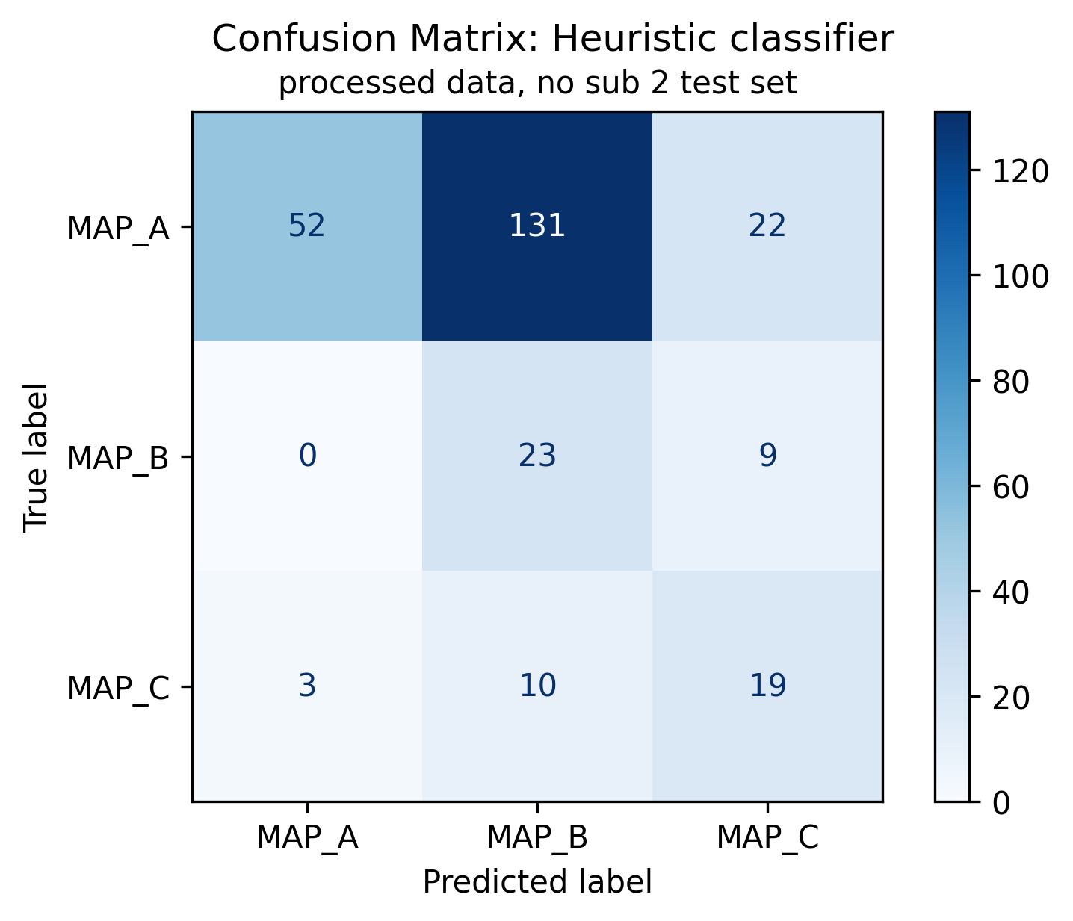
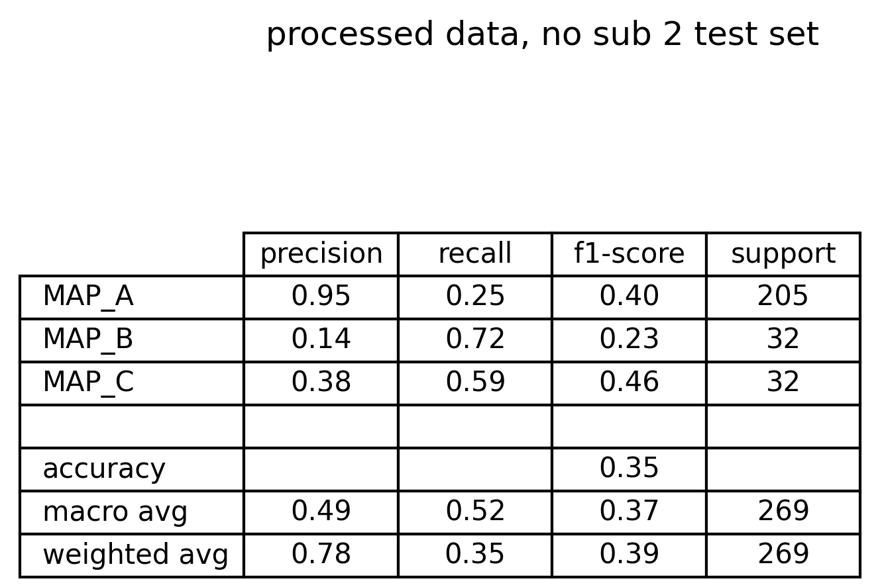
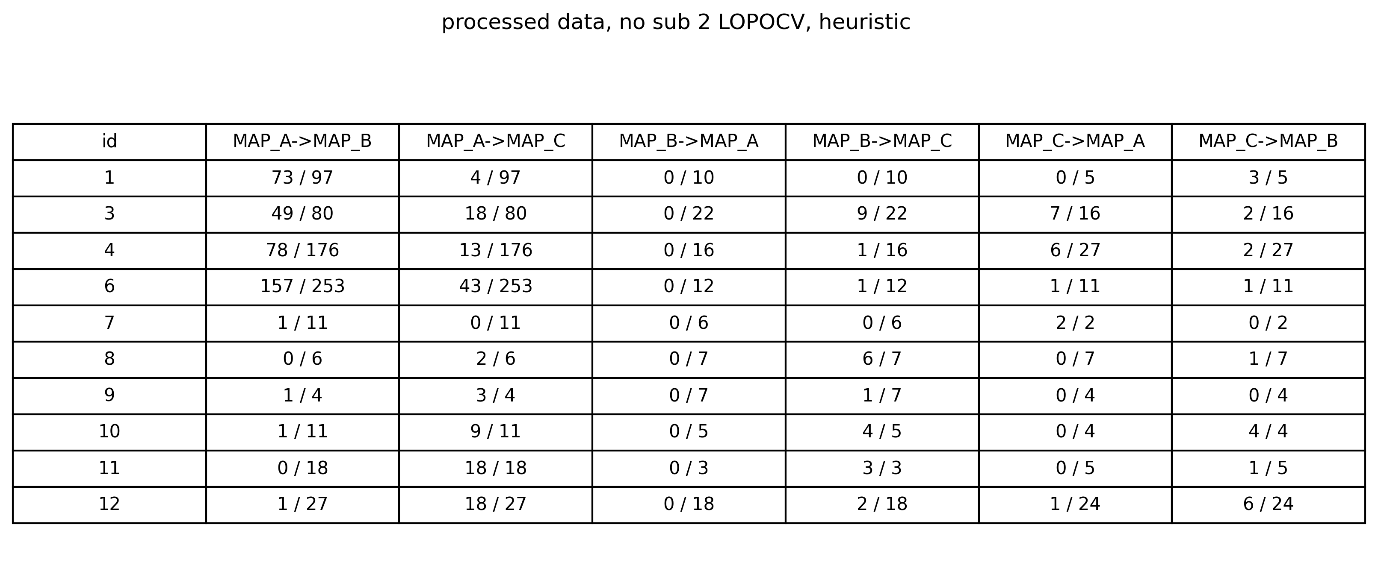
Appendix 4: What if ventricular phase is limited?
So far ventricular phase is defined as whatever follows 0.42 seconds, but some signals have evident artifacts from 0.6 seconds on.
So, if the ventricular segment is defined as
Ventricular phase: abs(record[t=0.42 : t=0.60 ])
would performance increase?
There are some improvements quantifiable with CM, performance metrics and, using LOPOCV, table of misclassified signals for each subject.
After Alignment sub 4

Slide 36
Appendix 5: are peaks subject specific?
By evaluating the ratio between the atrial peak and the ventricular peak one could try to find out if there are differences between MAP A and MAP B into this feature.
From boxplots seems that this feature could be slightly discriminative, even if a certain grade of overlap can be recognized.
Such fact suggest that the ratio between peaks might be subject specific.

